Slide 1

Unify Network & Endpoint Security
Troy Wojewoda
Security Analyst @BHIS

Slide 2

> quser
Troy Wojewoda
Security Analyst | Consultant | Threat Hunter | SOC | DFIR @BHIS
Previously…
FORENSICS
MALWARE ANALYST
(H|N)IDS
HOST
INCIDENT RESPONDER
THREAT HUNTER
SOC MANAGER
INTELLIGENCE
^
SECURITY ENGINEER
PCAP
NETWORK
Education/Certifications
BS Computer Engineering & Computer Science (CNU)
GSE, GRID, GNFA, GCFA, GCIH, GCIA, GREM, GAWN, GSEC (GOLD), CISSP

Slide 3

Endpoint vs. Network
How’s your NAC solution?
Mo IPoPs, Mo Problems
All you need is a good EDR!
Silver bullets are for werewolves, not computers!
(1) NSM : many
OS Agnostic
High Ground Advantage
Rogue | Unmanaged System Detection
Less Effective in Zero Trust Environments
Susceptible to Scalability Scenarios
Encryption Challenges
Team EDR
Team NSM
Depth
Breadth

Slide 4
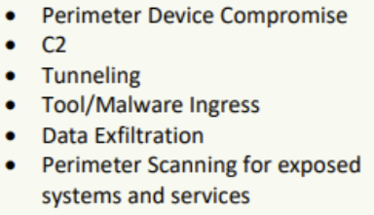
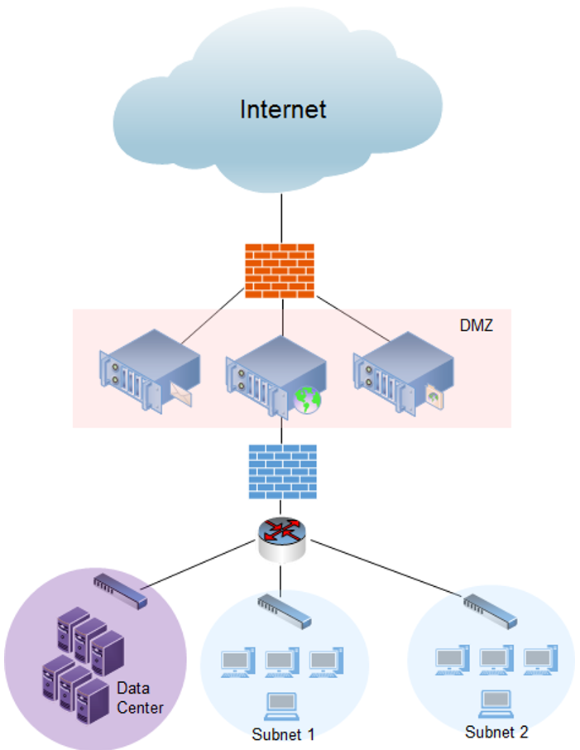
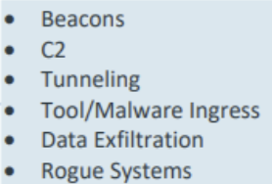
NSM Placement
Public IPs (NAT)
Private IP Space

Slide 5

Direct Correlation
Direct Correlation (IP/Transport)
Source IP address
src-ip:src-port -> dst-ip:dst-port
Community ID (Flow Hashing)
NAT (Network Address Translation)
VPNs (client IPs)

Slide 6
Correlation++
Beginning of Time…of assigned IP
DHCP
Operating System at the IP Layer
IP TTL
ICMP
Operating System/Software at the Application Layer
DNS
HTTP
NTP
TLS

Slide 7
EDR Telemetry
<INSERT YOUR EDR HERE>

Slide 8
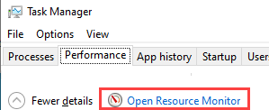
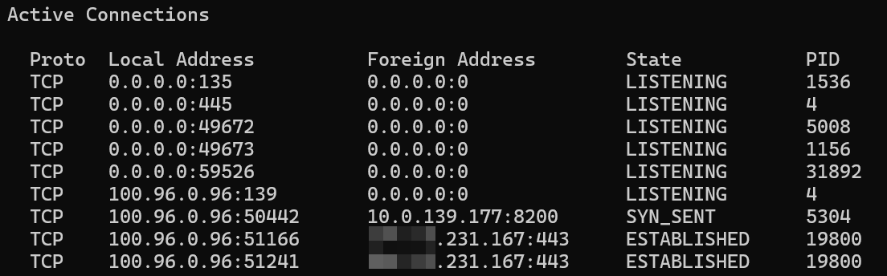
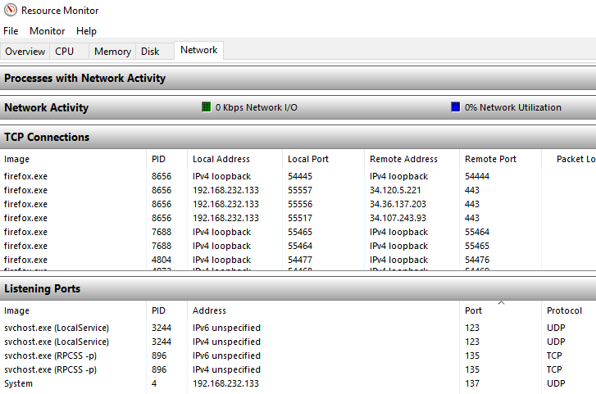
Endpoint – Windows
netstat –ano
netstat –bano
Requires admin permissions.
Displays the executable involved in creating each connection or listening port.

Slide 9
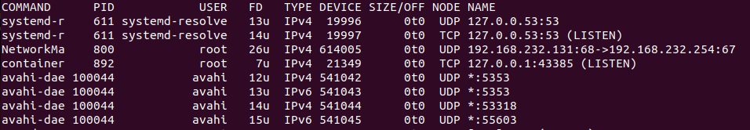
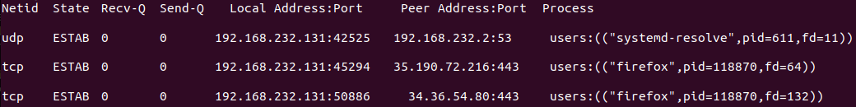
Endpoint – Linux
sudo lsof –i –n –P
sudo ss –tupn
BUT WAIT! THERE’S MORE
sudo netstat –tupn

Slide 10
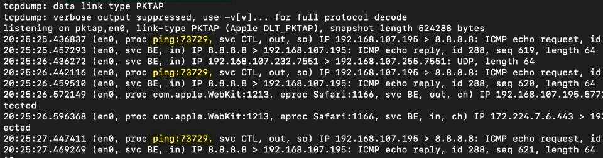
Endpoint – MacOS
tcpdump –i pktap,en0 –n -k
BUT WAIT! THERE’S MORE
sudo netstat –anv

Slide 11
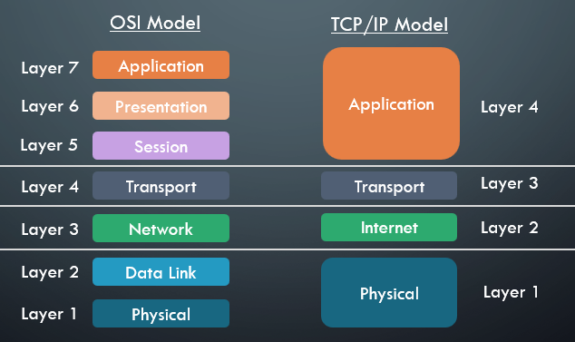
OSI & TCP/IP

Slide 12




OSI & TCP/IP – Visualized
Network A (20.30.200.20)
Scary Internet Cloud
Network B (104.18.16.133)
192.168.1.10
Application
10.100.1.50
Transport
?
?
Internet
NAT
Internet
NAT
Internet
Physical
Physical
Physical
Physical
Physical
Physical
Switch/Router
Switch/Router
Switch/Router
Switch/Router
Switch/Router
Data Packet

Slide 13
OSI & TCP/IP – Visualized
GET /index.html
Network A (20.30.200.20)
Scary Internet Cloud
Network B (104.18.16.133)
Net-B NAT’d Destination (Responding) IP
192.168.1.10:54321 → 104.18.16.133:80
20.30.200.20:54321 → 10.100.1.50:80
Originating Traffic
192.168.1.10
Application
10.100.1.50
Transport
?
?
Internet
NAT
Internet
NAT
Internet
Physical
Physical
Physical
Physical
Physical
Physical
Switch/Router
Switch/Router
Switch/Router
Switch/Router
Switch/Router
00:50:56:f1:00:c2 → 00:00:ff:c1:2c:a9
Both Src/Dst MACs changes at every layer-2 hop
20.30.200.20:54321 → 104.18.16.133:80
May change during NAT
Net-A NAT’d Source (Originating) IP Address
Data Packet

Slide 14

Got community-id?

Slide 15
community-id
Got community-id?
SIEM (Elastic, Splunk, etc.)
Corelight/community-id-spec
https://github.com/corelight/pycommunityid
https://github.com/corelight/community-id-spec
https://zeek.org/2019/07/an-update-on-community-id/
Zeek
Wireshark/TShark

Slide 16
community-id
The 5 tuple of a network connection is also commonly used to identify, correlate, or associate traffic in an environment between two hosts.
Community ID Flow Hashing:
(SRC_IP | SRC_PORT) | (DEST_IP – DST_PORT) | (PROTOCOL)
1:hO+sN4H+MG5MY/8hIrXPqc4ZQz0=

Slide 17
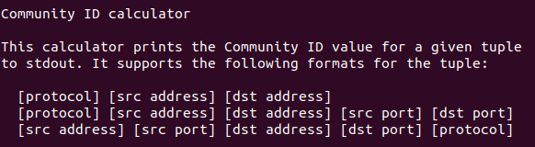
community-id
usage: community-id [-h] [--seed NUM] [--no-base64] [--verbose] ...

Slide 18
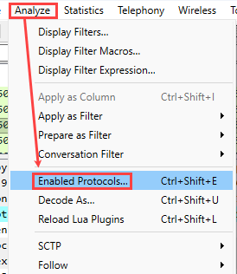
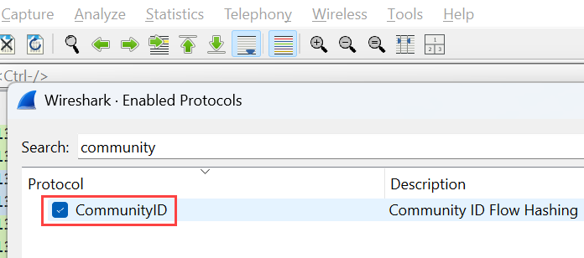
community-id (Wireshark)

Slide 19
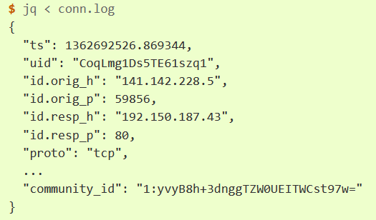
community-id (Zeek)
Included in Zeek 6+
Previously required installing an additional package via the package manager
Load: policy/protocols/conn/community-id-logging.zeek
Adds an additional community_id field to the Conn::Info record

Slide 20

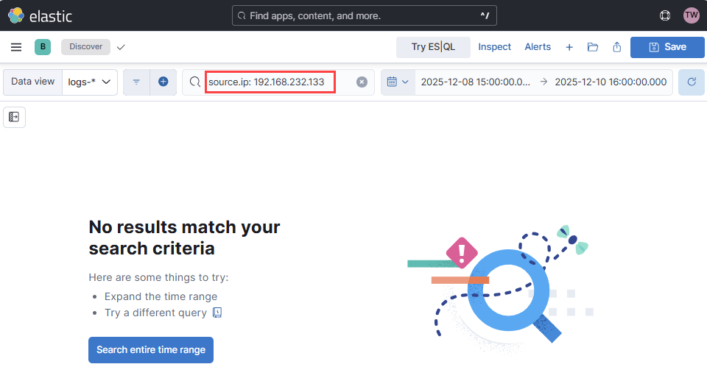
Where’s my EDR?

Slide 21
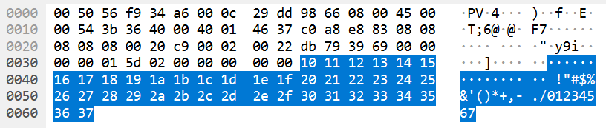
Network Protocols Provide Insight
DHCP
Inform/Request – MAC, Assigned/Requested IP, Hostname
DNS
OS and Application Traffic
NTP
OS and Application Traffic
HTTP
User-Agents
TLS
JA3/JA4
SNI Field
IP
IP TTL (Windows: 128, Linux/Mac: 64, Appliances/etc: 255)
ICMP
Payload Field
abcdefghijklmnopqrstuvwabcdefghi (win)
0x10…0x37 (linux/mac)

Slide 22
DHCP
Message Type | Sender | Purpose
DHCPDISCOVER | Client | Broadcast message sent to locate available DHCP servers. The client has no IP address yet.
DHCPOFFER | Server | Response to DHCPDISCOVER, offering an IP address, lease duration, and other configuration parameters.
DHCPREQUEST | Client | Sent by the client to accept a specific server's offer or to renew its current IP lease.
DHCPACK | Server | Acknowledges the DHCPREQUEST, confirms the lease, and finalizes the configuration parameters.
DHCPNAK | Server | Negative Acknowledgment. Sent to reject a DHCPREQUEST (e.g., if the requested IP is no longer available).
DHCPDECLINE | Client | Notifies the server that the offered IP address is already in use (e.g., detected by an Address Resolution Protocol/ARP check).
DHCPRELEASE | Client | Informs the server that the client is voluntarily giving up its IP address, allowing the server to immediately return it to the available pool.
DHCPINFORM | Client | Requests additional local configuration parameters (like DNS or NTP server addresses) from the server after the client already has a valid IP address.

Slide 23
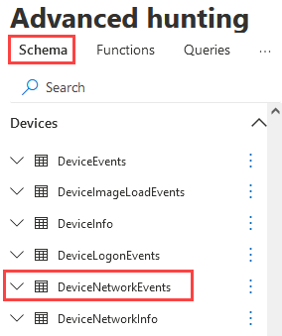
NSM in the Cloud-ish (Zeek – DfE)
Option 1: M365 Defender Portal
Hunting -> Advanced Hunting
Option 2: Graph API
https://graph.microsoft.com/v1.0/security/microsoft.graph.security.runHuntingQuery
Schema:
Devices -> DeviceNetworkEvents

Slide 24
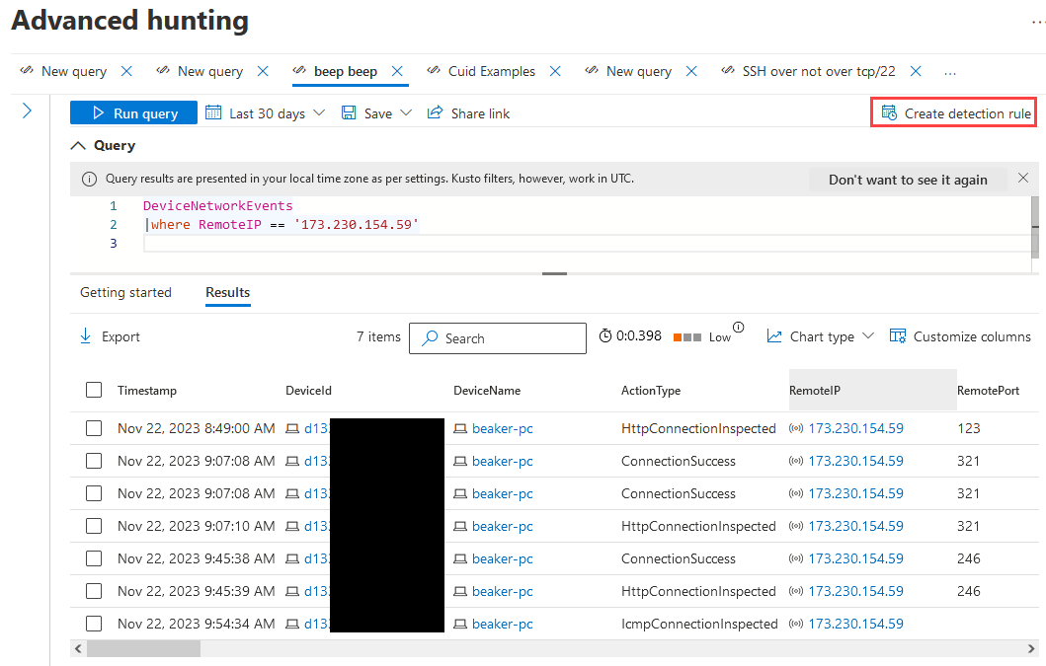
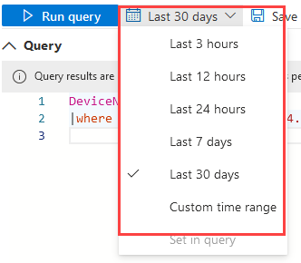
NSM in the Cloud-ish

Slide 25
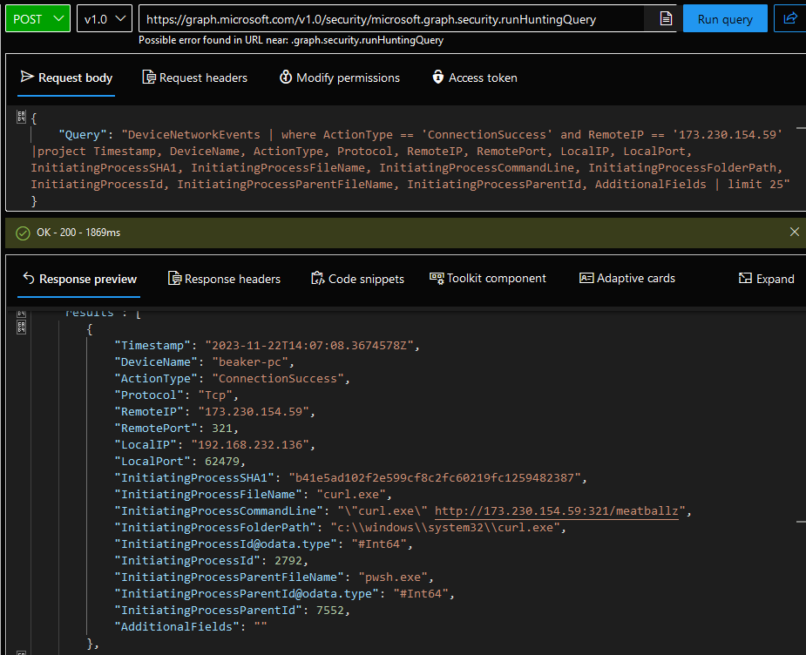
NSM in the Cloud-ish

Slide 26
Extra Toppings
DHCP Logs (Mapping Host:IP)
NetFlow (community-id/flow hashing)
Web Proxy/Gateway Logs (Mapping Host:IP)
Sysmon (coming soon standard to a neighborhood near you…)
EID 3 - no record of half-open TCP connections
EID 22 – no record of “direct-process” DNS activity

Slide 27
Summary
Endpoint Telemetry – Ground Zero (Most Context)
Network Activity – Bird’s Eye View (High Ground)
Network Flow Data – Provides additional opportunities for correlation that scale
Correlation is key but not always possible
Always be looking for more dance moves
Continually Audit Data Sources
Gaps in coverage
Systems lacking EDR or similar technology

Slide 28
Upcoming…
Check out my upcoming training opportunities!
Workshop: Foundations of Network Forensics & Analysis
Date: January 30, 2025
Course: Network Forensics & Incident Response
Conference: WWHF @ Mile High (in-Person or Virtual)
Dates: February 10 – 11, 2026

Slide 29
0x3F
Black Hills Information Security
http://www.blackhillsinfosec.com
@BHInfoSecurity
Troy Wojewoda
@wojeblaze
https://www.linkedin.com/in/troy-wojewoda-92387183

