Slide 1
Exploring PowerShell Logging with TellTail
by Carrie Roberts

Slide 2
2006 PC/Mobile/Web App Developer (HP)
2014 Penetration Tester (BHIS)
2017 Red Teamer / Blue Teamer ( Walmart*)
16 GIAC Certs, GPEN, GCWN GREM …
GIAC Security Expert GSE
Author Open-Source InfoSec Tools
Maintainer for Atomic Red Team
Blogger and Conference Speaker (DerbyCon, WWHF, Sp4rkCon, Bsides)
Masters Degree in Computer Science
SANS Masters Degree in InfoSec
Connect with me on Twitter and Discord!
* My presentation, comments and opinions are provided in my personal capacity and not as a representative of Walmart. They do not reflect the views of Walmart and are not endorsed by Walmart.

Slide 3
PowerShell for InfoSec: What you Need to Know!
PowerShell Fundamentals
Execution Policy
Session History and History File
Modules
Integrated Dev Environment (IDE)
Logging & Logging Bypasses
Popular PowerShell Attack Tools
AMSI Bypass
Language Modes
Credentials & Remote Administration
Just Enough Administration (JEA)
PowerShell without PowerShell.exe
PowerShell Core
Wrap-up
Notes:
Teaching concepts, ways it is used and abused. Not teaching you to be an admin or pro scripter.

Slide 4
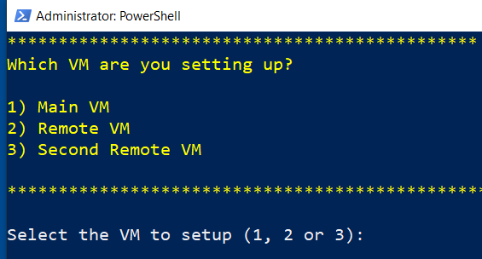
Setup Your Lab Environment
https://1drv.ms/w/s!AvDXyd4cgfxezQtZhLSUDfsHTV5g?e=IgfeaX
Download Windows 10 VM (7GB)
Open in VMware
Run setup script
Notes:
Teaching concepts, ways it is used and abused. No teaching you to be an admin.

Slide 5
Logging

Slide 6
PowerShell Versions
PS v3
PS v4
PS v5
Constrained Language Mode (CLM)
Remoting
Script Block Logging
Desired State Configuration (DSC)
Just Enough Admin (JEA)
Suspicious Script Block Logging
Module Logging
Transcription Logging

Slide 7
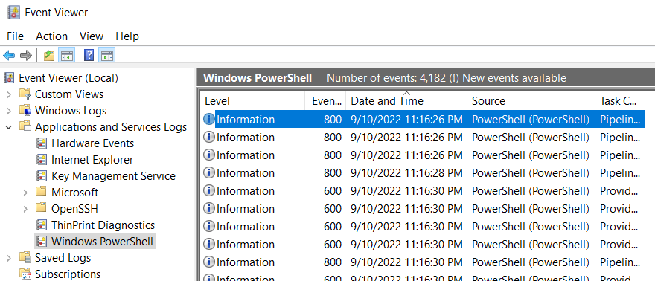
Default PowerShell Logging
Windows PowerShell Log
Default log size: 15 MB
Notes:
Example Query from Lee Homes to find downgrade attacks
Get-WinEvent -LogName "Windows PowerShell" | Where-Object Id -eq 400 | Foreach-Object { $version = [Version] ( $_.Message -replace '(?s).*EngineVersion=([\d\.]+)*.*','$1') if($version -lt ([Version] "5.0")) { $_ } }

Slide 8
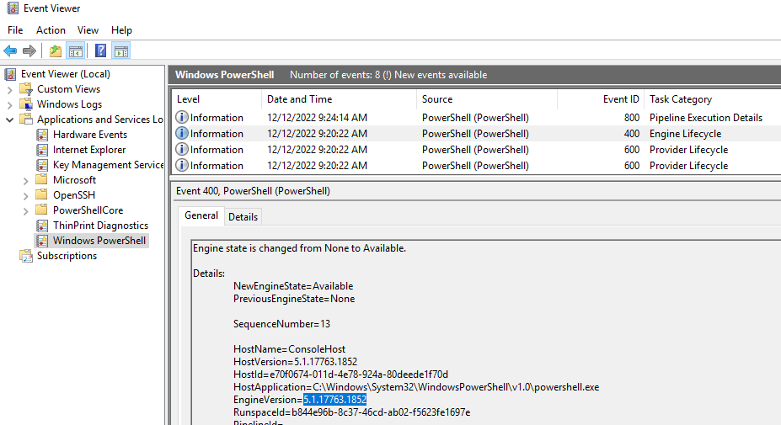
Engine Lifecycle Events (400)
Notes:
Example Query from Lee Homes to find downgrade attacks
Get-WinEvent -LogName "Windows PowerShell" | Where-Object Id -eq 400 | Foreach-Object { $version = [Version] ( $_.Message -replace '(?s).*EngineVersion=([\d\.]+)*.*','$1') if($version -lt ([Version] "5.0")) { $_ } }

Slide 9
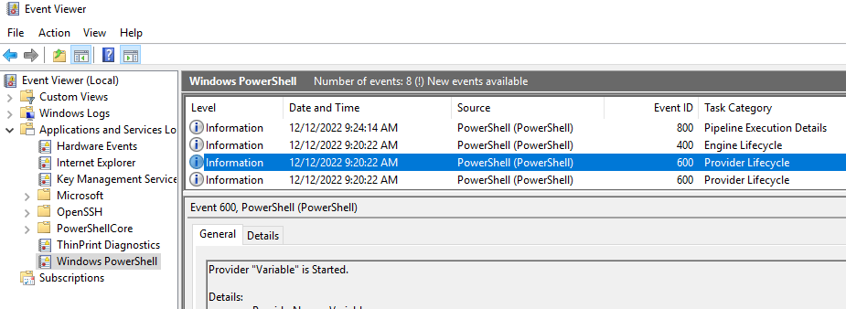
Provider Lifecycle Events (600)
Notes:
Example Query from Lee Homes to find downgrade attacks
Get-WinEvent -LogName "Windows PowerShell" | Where-Object Id -eq 400 | Foreach-Object { $version = [Version] ( $_.Message -replace '(?s).*EngineVersion=([\d\.]+)*.*','$1') if($version -lt ([Version] "5.0")) { $_ } }

Slide 10
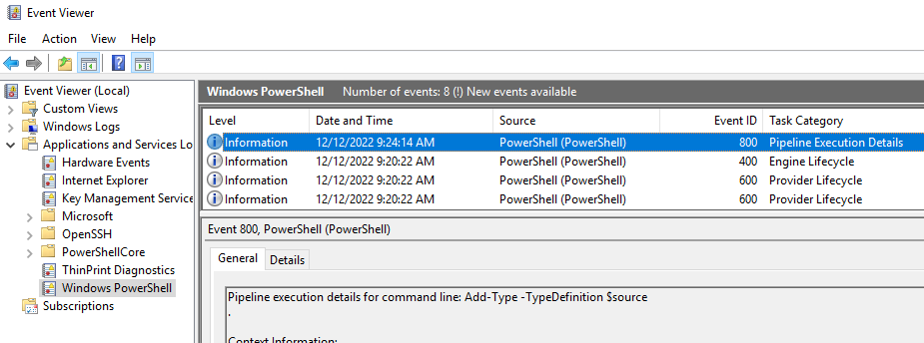
Pipeline Execution Details (800)
Notes:
Example Query from Lee Homes to find downgrade attacks
Get-WinEvent -LogName "Windows PowerShell" | Where-Object Id -eq 400 | Foreach-Object { $version = [Version] ( $_.Message -replace '(?s).*EngineVersion=([\d\.]+)*.*','$1') if($version -lt ([Version] "5.0")) { $_ } }

Slide 11
PowerShell Downgrade Attacks
PS v3
PS v4
PS v5
Constrained Language Mode (CLM)
Remoting
Script Block Logging
Desired State Configuration (DSC)
Just Enough Admin (JEA)
Suspicious Script Block Logging
Module Logging
Transcription Logging

Slide 12
Detecting Downgrade Attacks
Notes:
Disable-WindowsOptionalFeature -Online -FeatureName MicrosoftWindowsPowerShellV2Root
https://www.leeholmes.com/detecting-and-preventing-powershell-downgrade-attacks/
above shows how to block execution of older versions
https://www.leeholmes.com/detecting-and-preventing-powershell-downgrade-attacks/
Get-WinEvent -LogName "Windows PowerShell" |
Where-Object Id -eq 400 |
Foreach-Object {
$version = [Version] (
$_.Message -replace '(?s).*EngineVersion=([\d\.]+)*.*','$1')
if($version -lt ([Version] "5.0")) { $_ }
}

Slide 13
Prevent Downgrade Attacks
Get-WindowsOptionalFeature -Online -FeatureName MicrosoftWindowsPowerShellV2
Disable-WindowsOptionalFeature -Online -FeatureName MicrosoftWindowsPowerShellV2Root
Notes:
Disable-WindowsOptionalFeature -Online -FeatureName MicrosoftWindowsPowerShellV2Root
https://www.leeholmes.com/detecting-and-preventing-powershell-downgrade-attacks/
above shows how to block execution of older versions
https://www.leeholmes.com/detecting-and-preventing-powershell-downgrade-attacks/
Get-WinEvent -LogName "Windows PowerShell" |
Where-Object Id -eq 400 |
Foreach-Object {
$version = [Version] (
$_.Message -replace '(?s).*EngineVersion=([\d\.]+)*.*','$1')
if($version -lt ([Version] "5.0")) { $_ }
}

Slide 14
What is “Suspicious”?
AddSecurityPackage
Add-Type
AdjustTokenPrivileges
AllocHGlobal
BindingFlags
Bypass
CloseHandle
CreateDecryptor
CreateEncryptor
CreateProcessWithToken
CreateRemoteThread
CreateThread
CreateType
CreateUserThread
Cryptography
CryptoServiceProvider
CryptoStream
DangerousGetHandle
DeclaringMethod
DeclaringType
DefineConstructor
DefineDynamicAssembly
DefineDynamicModule
DefineEnum
DefineField
DefineLiteral
DefinePInvokeMethod
DefineType
DeflateStream
DeviceIoControl
DllImport
DuplicateTokenEx
Emit
EncodedCommand
EnumerateSecurityPackages
ExpandString
FreeHGlobal
FreeLibrary
FromBase64String
GetAssemblies
GetAsyncKeyState
GetConstructor
GetConstructors
GetDefaultMembers
GetDelegateForFunctionPointer
GetEvent
GetEvents
GetField
GetFields
GetForegroundWindow
GetInterface
GetInterfaceMap
GetInterfaces
GetKeyboardState
GetLogonSessionData
GetMember
GetMembers
GetMethod
GetMethods
GetModuleHandle
GetNestedType
GetNestedTypes
GetPowerShell
GetProcAddress
GetProcessHandle
GetProperties
GetProperty
GetTokenInformation
GetTypes
ILGenerator
ImpersonateLoggedOnUser
InteropServices
IntPtr
InvokeMember
kernel32
LoadLibrary
LogPipelineExecutionDetails
MakeArrayType
MakeByRefType
MakeGenericType
MakePointerType
Marshal
memcpy
MemoryStream
Methods
MiniDumpWriteDump
NonPublic
OpenDesktop
OpenProcess
OpenProcessToken
OpenThreadToken
OpenWindowStation
PasswordDeriveBytes
Properties
ProtectedEventLogging
PtrToString
PtrToStructure
ReadProcessMemory
ReflectedType
RevertToSelf
RijndaelManaged
ScriptBlockLogging
SetInformationProcess
SetThreadToken
SHA1Managed
StructureToPtr
ToBase64String
TransformFinalBlock
TypeHandle
TypeInitializer
UnderlyingSystemType
UnverifiableCodeAttribute
VirtualAlloc
VirtualFree
VirtualProtect
WriteByte
WriteInt32
WriteProcessMemory
ZeroFreeGlobalAllocUnicode
Notes:
[ScriptBlock].GetField('signatures','NonPublic,Static').GetValue($null) | sort | out-file order.txt

Slide 15
Script Block Logging
PowerShell Operational Log
Logs processing of commands, script blocks, functions, and scripts (interactive or automated)
Note: Only logs full script block the first time run in the current session
Event ID 4104 (optional start/stop logging 4105/4106)
HKLM:\Software\Policies\Microsoft\Windows\PowerShell\ScriptBlockLogging\EnableScriptBlockLogging
Default log size: 15MB
Notes:
Event viewer: Applications and Services Logs/Microsoft/Windows/PowerShell/Operational

Slide 16
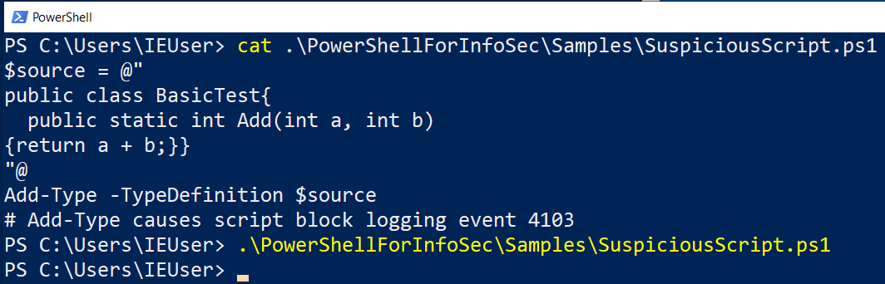
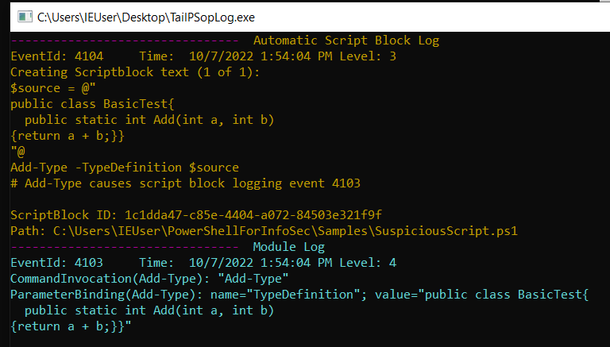
Suspicious Script Block Logging Example

Slide 17
Suspicious Script Block Logging Example
with script block logging explicitly disabled
with module logging explicitly disabled

Slide 18
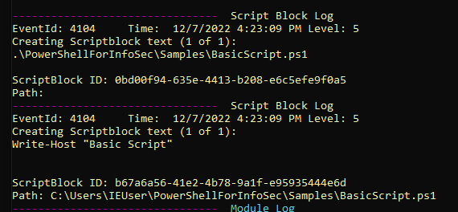
Basic Script Block Logging Example

Slide 19
Script Block Start/Stop Logging
Event ID 4105 (start) and 4106 (stop)
HKLM:\Software\Policies\Microsoft\Windows\PowerShell\ScriptBlockLogging\EnableScriptBlockInvocationLogging
Excessive logs ...

Slide 20
Module Logging
PowerShell Operational Log
Logs all execution details of PS modules ran (can be filtered)
Event ID 4103
HKLM:\Software\Policies\Microsoft\Windows\PowerShell\ModuleLogging\EnableModuleLogging
HKLM:\Software\Policies\Microsoft\Windows\PowerShell\ModuleLogging\ModuleNames

Slide 21
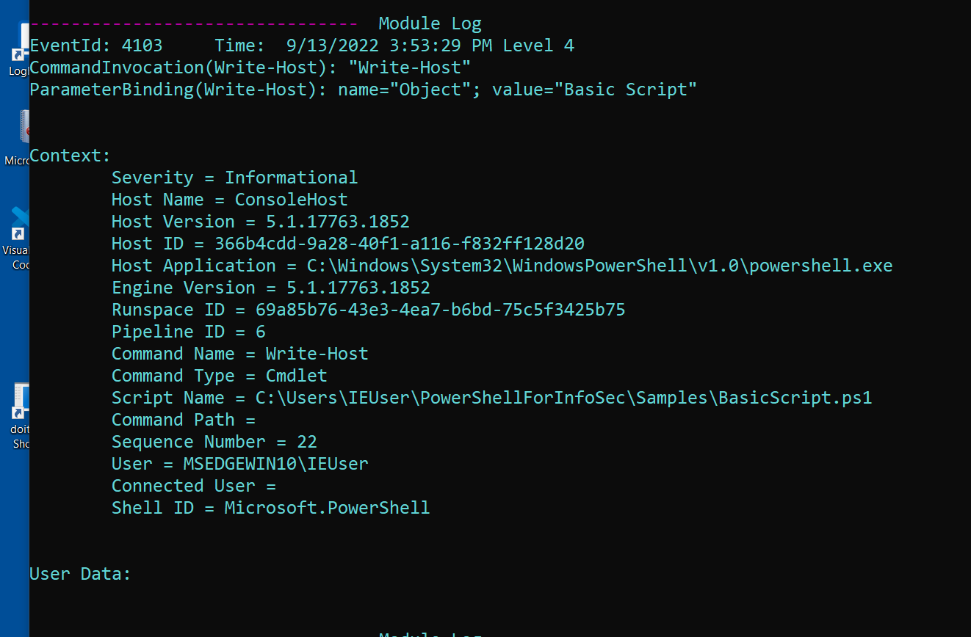
Basic Module Logging Example

Slide 22
Transcription Logging
Create new log entry for each PS session
Includes input and output “over the shoulder”
HKLM:\Software\Policies\Microsoft\Windows\PowerShell\Transciption\EnableTranscripting
HKLM:\Software\Policies\Microsoft\Windows\PowerShell\Transciption\EnableTranscripting\OutputDirectory
Will not include content of executed scripts or output written to other destinations such as files
Large files will be broken up into multiple logs

Slide 23
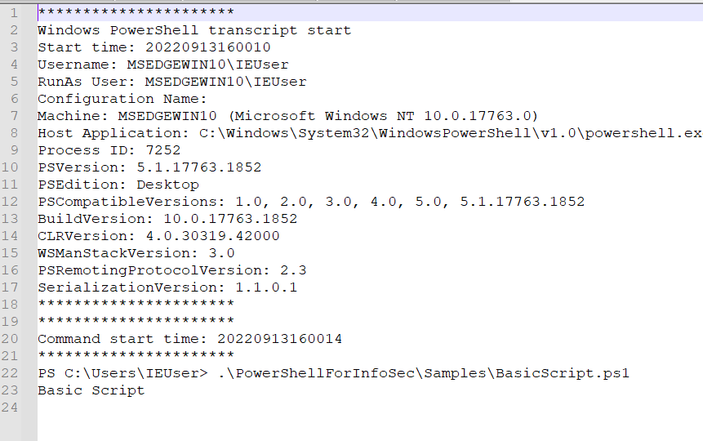
Basic Transcription Logging Example

Slide 24
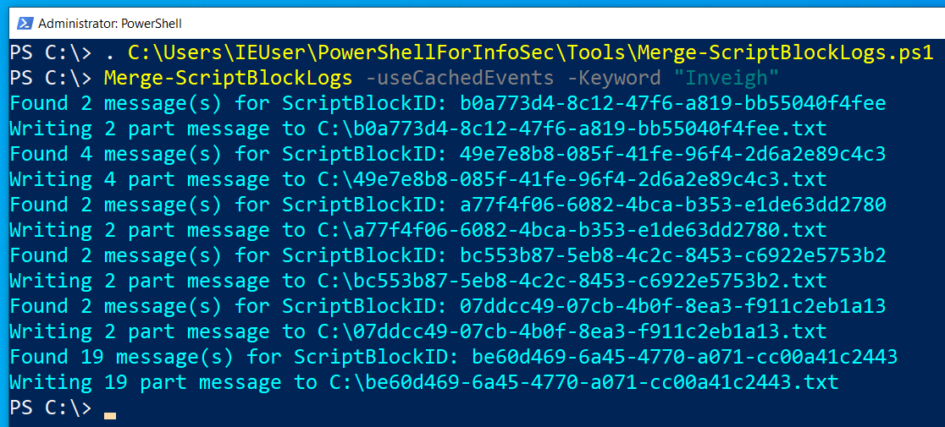
Combine Multi-Part Script Block Event Logs

Slide 25
Wrap-Up

Slide 26
Get the Tools
TellTail
Tail PowerShell Logs
Turn Logging On/Off (Log Menu)
Merge Multi-Part Script Block Logs

Slide 27
PowerShell for InfoSec: What you Need to Know!
PowerShell Fundamentals
Execution Policy
Session History and History File
Modules
Integrated Dev Environment (IDE)
Logging & Logging Bypasses
Popular PowerShell Attack Tools
AMSI Bypass
Language Modes
Credentials & Remote Administration
Just Enough Administration (JEA)
PowerShell without PowerShell.exe
PowerShell Core
Wrap-up
Notes:
Teaching concepts, ways it is used and abused. Not teaching you to be an admin or pro scripter.

Slide 28
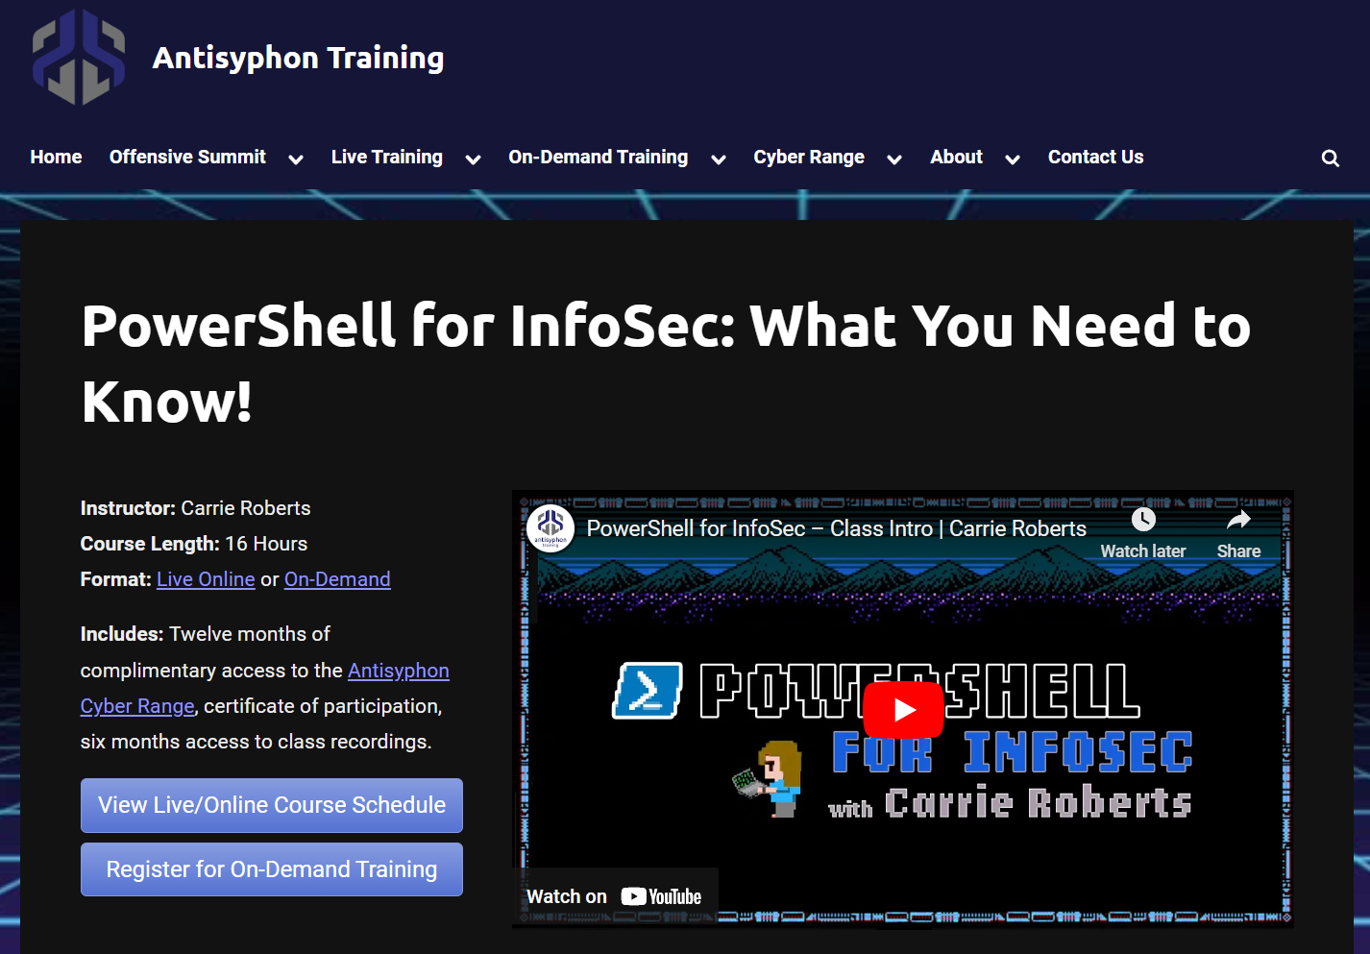
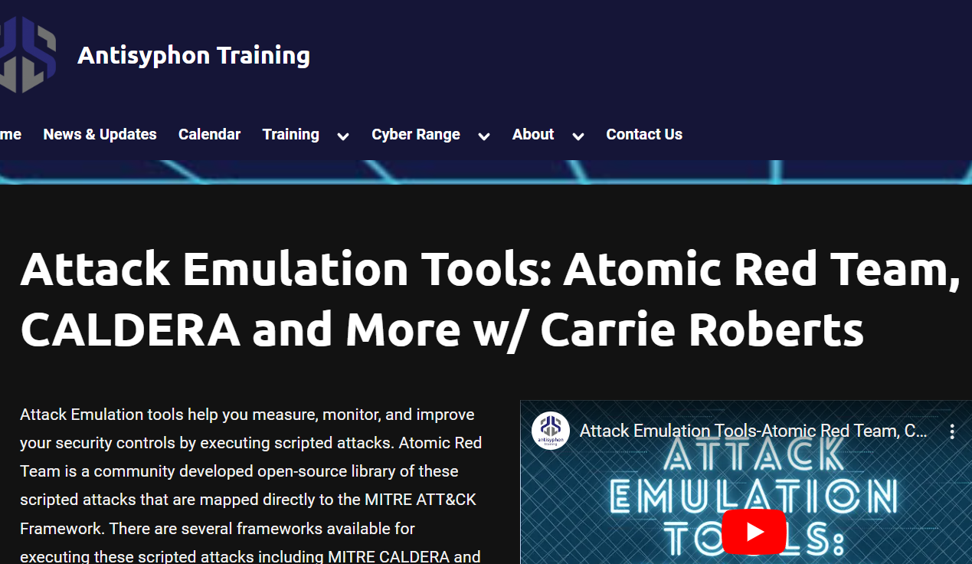
More Classes from Antisyphon Training
https://www.antisyphontraining.com/training-calendar/

Slide 29
Thank You!
Stay Connected with me on Twitter and Discord!

